Slide 1
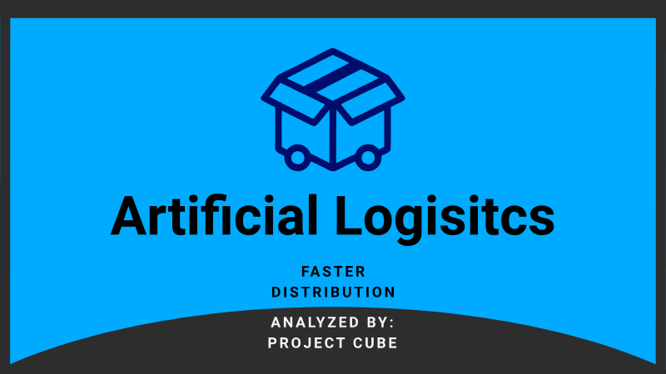

Slide 2
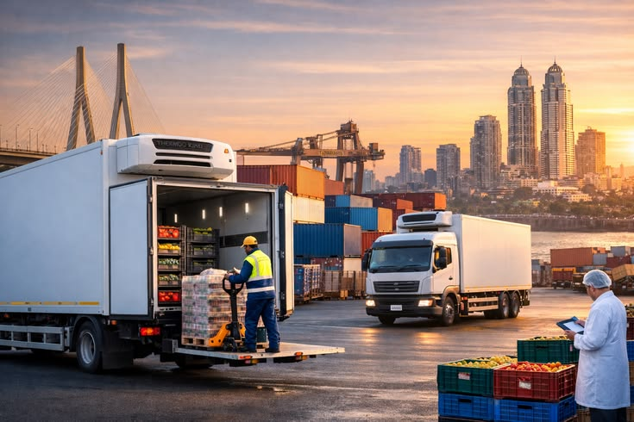
ARTIFICIAL LOGISTICS
In all honesty, this is an AI generated task that I had asked for as a practical to understand and become an operational analyst. This task is called 'Food Distributor', the AI was my client that had a problem with its business that transports food products from the North, South, East and West and is currently stationed South.
Follow Next Page>>>

Slide 3
Situation
One central warehouse
One cold storage
Revenue is growing, but cash flow is tight
Some clients complain about late deliveries
They throw away too much stock due to expiry
Follow Next Page>>>

Slide 4
Information
Fast-casual restaurants
Try drive-thru
Must be a website for the restaurant, helps for time decision-making while on the road, must be games and earn points and rewards
Restaurants drive volume and grocery stores drive stability
Most wastage comes from restaurant-driven stock and most cash-flow pressure comes from restaurant payment terms
Follow Next Page>>>

Slide 5
Regions:
North, South, East, and West
Traffic is heavy in North and East
One central warehouse:
Would be a problem if anything would to happen to it, build at least 2 more (but that can be dealt with due to cashflow)
Located in the South
Stock up more cold storages
Daily deliveries to restaurants and 2-3 deliveries per week to grocery store and yet they all come from one warehouse with cold storage
Follow Next Page>>>

Slide 6
Suppliers require payment within 7-14 days
“Cash flow is tight”
Customers, within restaurants, pay 30 days after delivery
Must pay suppliers before we get paid
Cash tied up in stock
“On paper we’re profitable, but the bank balance feels low”
Late deliveries:
Find out the routes
Install tracking devices into trucks
Ask the drivers which route results them to having traffic
Download the ‘WAZE’ app to avoid traffic and unnecessary stops
Follow Next Page>>>

Slide 7
Goal
Names of the clients/customers, id and type and region
Take the cost price and selling price to see a difference
Selling price multiplied by quantity to know the price you’re selling at
Join inventory, product and order tables together
Order date and delivery date summed up to see a difference
Product name and shelf life days
Delivery date minus (-) by order date = days_of_delivery
Follow Next Page>>>

Slide 8
Insert the inventories station (South)
When groceries stores payment terms days extents 15 days, then interest rate increase and if 15 more days extent, then no supply provide (do the same for restaurant)
Inventory summary:
Product_id, product_name, order_id, category, selling_price and join them
Use the ‘when’ clause previously
<<<End Page

